Slide 1



SATs Information Evening
Monday 5th
October 2026

Slide 2
Structure of the evening
6:00-6:15pm Information about SATs and SATs week
6:15-6:30pm
Maths session
6:30-6:45pm English session
6:45pm
Questions?

Slide 3
2027 Test timetable
Monday 10th May | Tuesday 11th May | Wednesday 12th May | Thursday 13th May
English grammar, punctuation and spelling test. Paper 1: Short answer questions Paper 2: Spelling | English reading test | Mathematics. Paper 1: arithmetic Paper 2: reasoning | Mathematics. Paper 3: reasoning

Slide 4
Participation in the tests
Pupils working well below the standard of the tests. Pupils can be disapplied if they are working below Key Stage 2 standards. Parents will be informed and a report shared with them as to the reasons for your child not sitting the SATs and what we are doing in school to support your child.
Access arrangements- must be based on normal classroom practice.
Small groups- some pupils will be put into small groups to aid their concentration or so we can support them with further access arrangements.
Absence as a result of illness during test week- please let reception know in the morning before school starts. Mrs Cull will phone to speak to you about timetable variations.

Slide 5
Score conversions (pass marks)
 | 2022 | 2023 | 2024 | 2025 | 2026
Maths /110 | 58 | 56 | 54 | 58 | 56
Reading /50 | 29 | 24 | 27 | 28 | 25
Grammar, punctuation and spelling /70 | 35 | 36 | 35 | 35 | 34

Slide 6
Scaled scores
A scaled score of 100 will always represent
the ‘expected standard’.
The pupil’s raw score will be translated into a scaled score.
Scaled scores help test results to be reported consistently from one year to the next. National curriculum tests are designed to be as similar as possible year on year, but slight differences in difficulty will occur between years. Scaled scores maintain their meaning over time so that two pupils achieving the same scaled score in different years will have demonstrated the same attainment.
The lowest scaled score that can be awarded is 80 and the highest is 120. 110 is unofficially classed as greater depth/Mastery.

Slide 7
The results
Raw score.
A scaled score.
Confirmation of whether or not they attained the expected standard (AS/NS)
Teacher Assessment- Writing, science and pre-key stage.
TA for KS2 English writing is subject to statutory external moderation.

Slide 8
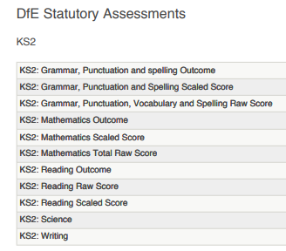

Test results and teacher assessments

Slide 9
Teacher assessments
Subject | Teacher assessment code
Writing | EXS
Science | EXS
KS2 science teacher assessment codes
For KS2 science there are two standards teachers are allowed to report:
working at the expected standard (EXS)
has not met the expected standard (HNM)

Slide 10
Teacher assessments
Subject | Teacher assessment code
Writing | GDS
Science | EXS
KS2 English writing teacher assessment codes
For KS2 English writing, teacher assessment is the primary outcome used for accountability as pupils do not sit a writing test. There are four standards teachers must use to report:
working towards the expected standard (WTS)
working at the expected standard (EXS)
working at greater depth within the expected standard (GDS)

Slide 11
Our results
Expected standard | Maths % | Reading % | SPaG % | Writing % | Combined %
2024 | 64 | 66 | 60 | 60 | 46
2025 | 74 | 72 | 61 | 73 | 57
2026 | 72 | 75 | 74 | 77 | 64
Greater depth | Maths % | Reading % | SPaG % | Writing % | Combined %
2024 | 11 | 21 | 15 | 12 | 5
2025 | 23 | 24 | 14 | 14 | 10
2026 | 23 | 26 | 27 | 14 | 8

Slide 12



Maths session
Our curriculum
The tests and sample questions
Calculation methods
What we do in school
Useful websites and books

Slide 13
Maths Curriculum Calendar
Where can you find the curriculum calendar?
School website
Curriculum
Mathematics
Scroll down to ‘Maths KS2’

Slide 14
Our curriculum- autumn term
TOPIC | STRAND | SUB-STRANDS
Number | Number 1 and place value, approximation and estimation/rounding | Read, write, order and compare numbers up to 10 000 000 Identify, represent and estimate; rounding. X and / by 10, 100 and 1000 Rounding Negative numbers Number problems.
Number | Addition, subtraction, multiplication and division (Calculations 1) | Add and subtract mentally Use all four operations and BIDMAS Add/subtract using written methods. Estimate, use inverse and check. Solve problems involving all four operations.
Geometry | Geometry 1- Properties of shapes 1 | Circle parts and circumference. Draw 2D shapes. Describe properties, compare and classify shapes.
Number | Addition, subtraction, multiplication and division (Calculations 2) | Multiply/divide mentally. Multiply/divide using written methods. Associate a fraction with division. Solve problems. Order of operations.
Measurement | Measurement 1 | Convert between metric units Convert metric/imperial Solve problems
Number | Number 2- Fractions, decimals and percentages 1 | Value of digits in decimals. Solve problems involving rounding. Simplify and find equivalent fractions. Fraction/decimal/% equivalence. X decimals. Division problems.
Statistics | Statistics | Interpret and construct pie charts and line graphs. Solve problems involving data. Mean average.

Slide 15
Our curriculum- spring term
TOPIC | STRAND | SUB-STRANDS
Number | Calculations 3 | Identify common factors and prime numbers. Order of operations. Use estimation to check answers.
Geometry | Geometry 2- Position and direction | Co-ordinates Translation and reflection.
Number | Ratio and proportion | Scale factor Sharing
Measurement | Measurement 2 | Perimeter Area Volume Converting units of measure
Number | Number 3 | Compare and order fractions Improper and mixed number fractions + and – fractions X fractions ÷ fractions
Geometry | Geometry 3- Properties of shape | 3D shapes Nets Drawing shapes Missing angles

Slide 16
Our curriculum- summer term
TOPIC | STRAND | SUB-STRANDS
Algebra | Algebra 1 | Simple formulae Missing number problems Sequences find pairs of numbers that satisfy number sentences involving two unknowns Enumerate (list) all possibilities of combinations of two variables
SATs week
For the remainder of the year classes will cover: Areas that need further work from the topics covered Calculator work Year 7 preparation Investigations and problem solving

Slide 17
Mathematics Test Papers
Children will sit three tests: Paper 1, Paper 2 and Paper 3.
Paper 1 is ‘Arithmetic’ and includes 36 questions for pupils to solve in 30 minutes. The paper does not include any word problems and focuses solely on calculation methods including for example the four operations and fractions, decimals and percentages.
Questions gradually increase in difficulty. Not all children will be expected to access some of the more difficult questions later in the paper.
Since the start of Year 5, pupils have been doing weekly arithmetic tests to prepare them for Paper 1 so that they are familiar with the timed element and what the test will look like.
Please if you are happy to, encourage your child to bring their arithmetic test home each week and go through the questions they got wrong with them, focussing particularly on silly mistakes.
Papers 2 and 3 cover ‘Problem Solving and Reasoning’ skills. Each test is made up of lots of worded problems and lasts for 40 minutes.
Pupils will still require calculation skills but will need to answer questions in context and decide what is required to find a solution.

Slide 18
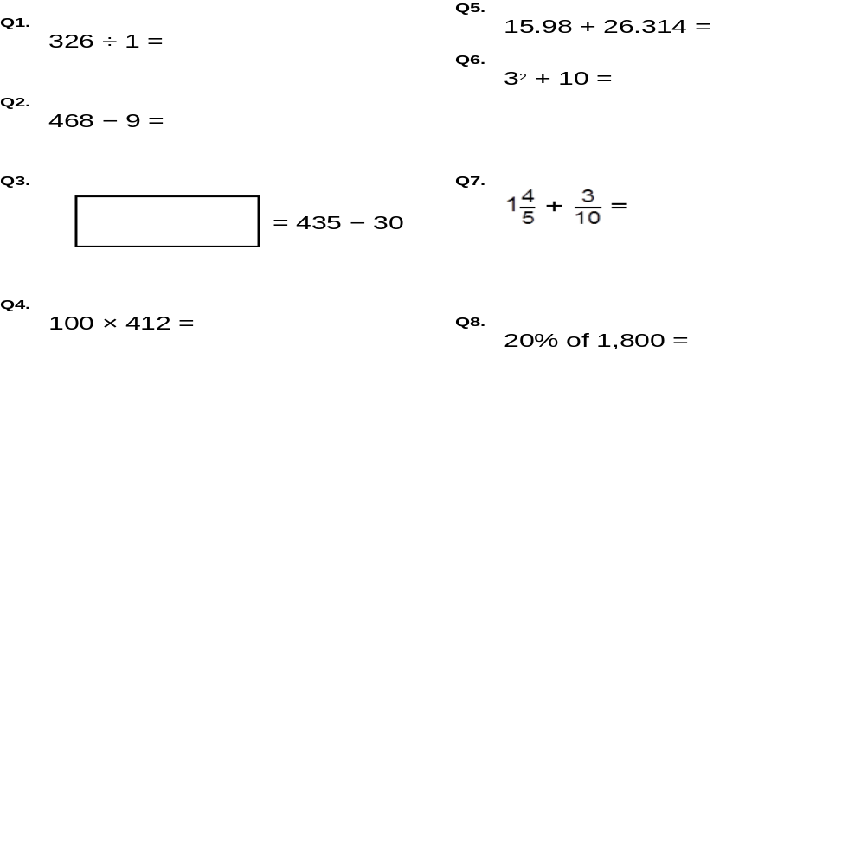
Sample Questions –Paper 1
Q30. 6574 x 31 Q32. 1118 ÷ 43
Q34. 2/5 x 140

Slide 19
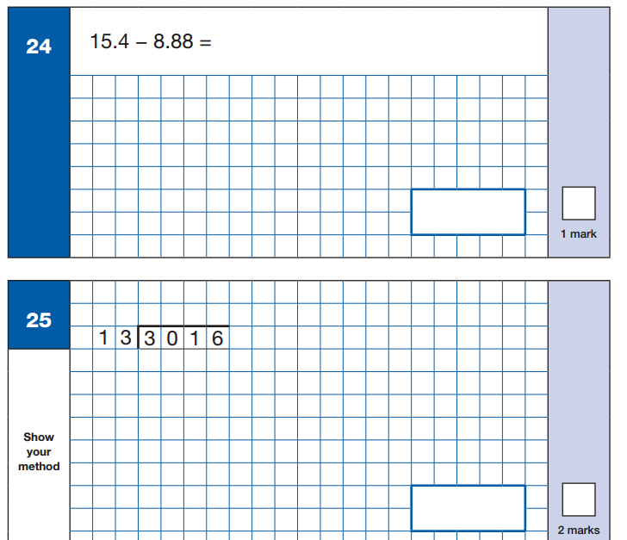
Sample questions – Paper 1

Slide 20
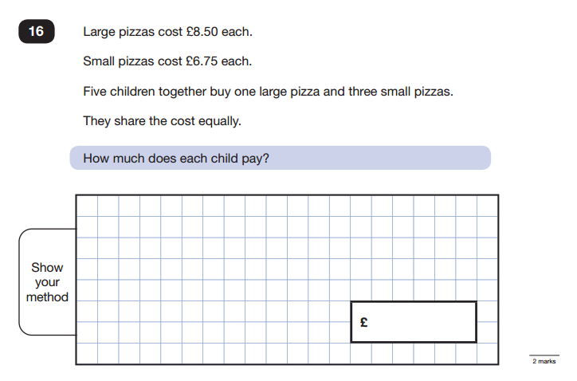
Sample Question – Paper 2 & 3

Slide 21
Calculation Methods
Weekly arithmetic tests
Weekly arithmetic lessons
Topic based lessons (e.g. calculating percentages of amounts requires multiplying and dividing)
Pupils are expected to use the traditional methods
KS2 Maths Workshop on Monday 2nd November 6pm-7pm

Slide 22
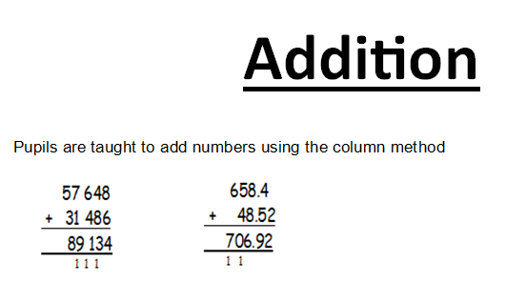
Calculation Methods

Slide 23
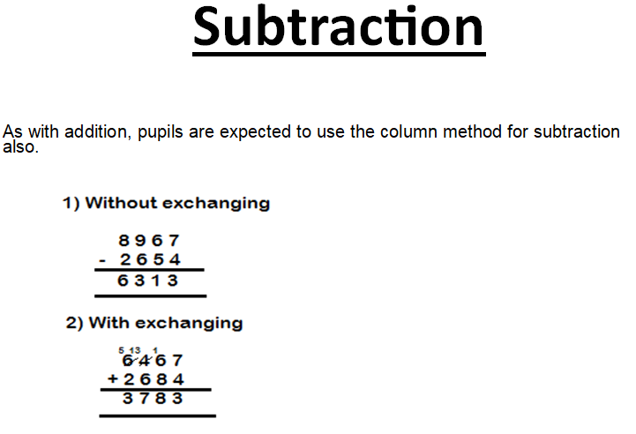
Calculation Methods
-

Slide 24
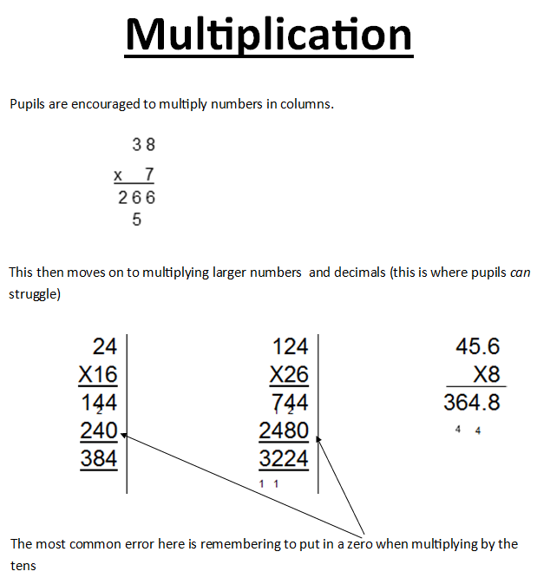
Calculation Methods

Slide 25
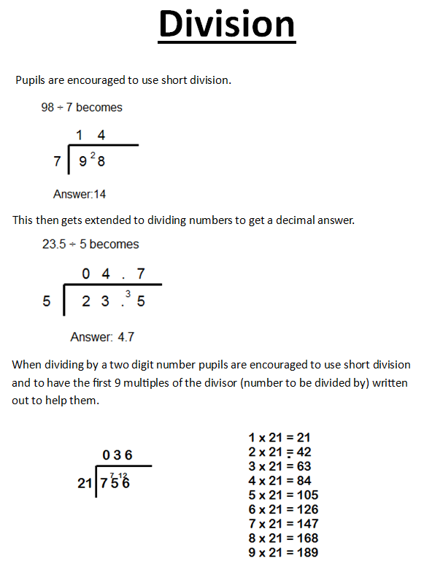
Calculation Methods

Slide 26


Ways we prepare the pupils:
Weekly arithmetic lessons
Weekly arithmetic tests
Weekly homework tasks (My Maths & TTR)
Four rounds of formal practice SATs (September, November, January and March) – please do not use past SATs papers found online

Slide 27

Ways to help at home:
Go through wrong answers in weekly arithmetic tests
Go through wrong answers in practise SATs papers
Continue to practise times tables - make it as fun as possible and use Times Table Rockstars to help with this.
Encourage the completion of two pieces of Maths homework each week

Slide 28
Useful books and websites....
CGP:
Targeted question book
SATs question book
Letts, Collins, Rising Stars – all do study guides
BBC Education have produced a whole host of materials for KS2. Follow the KS2 link and then select Maths. Some aspects require a subscription - http://www.bbc.co.uk/education
A site with Maths based quizzes which are marked as you go along - http://www.educationquizzes.com/ks2/maths/
A site with a range of information and questions – great for revision purposes! http://www.icteachers.co.uk/children/children_sats.htm

Slide 29


The English KS2
Standard Attainment Tests

Slide 30

The English tests:
Monday 10th May -English Grammar, Punctuation and Spelling (SPAG)
SPAG Paper 1: 45 minutes, 50 marks
Monday 10th May -English Grammar, Punctuation and Spelling (SPAG)
SPAG Paper 2: approximately 15 minutes, 20 marks
Tuesday 11th May -English Reading paper: 60 minutes, 50 marks
Writing will be Teacher Assessed, as in recent years, so there is no formal test for this .
Please be aware that SPaG and Reading are separate scores – they do not get added together.

Slide 31
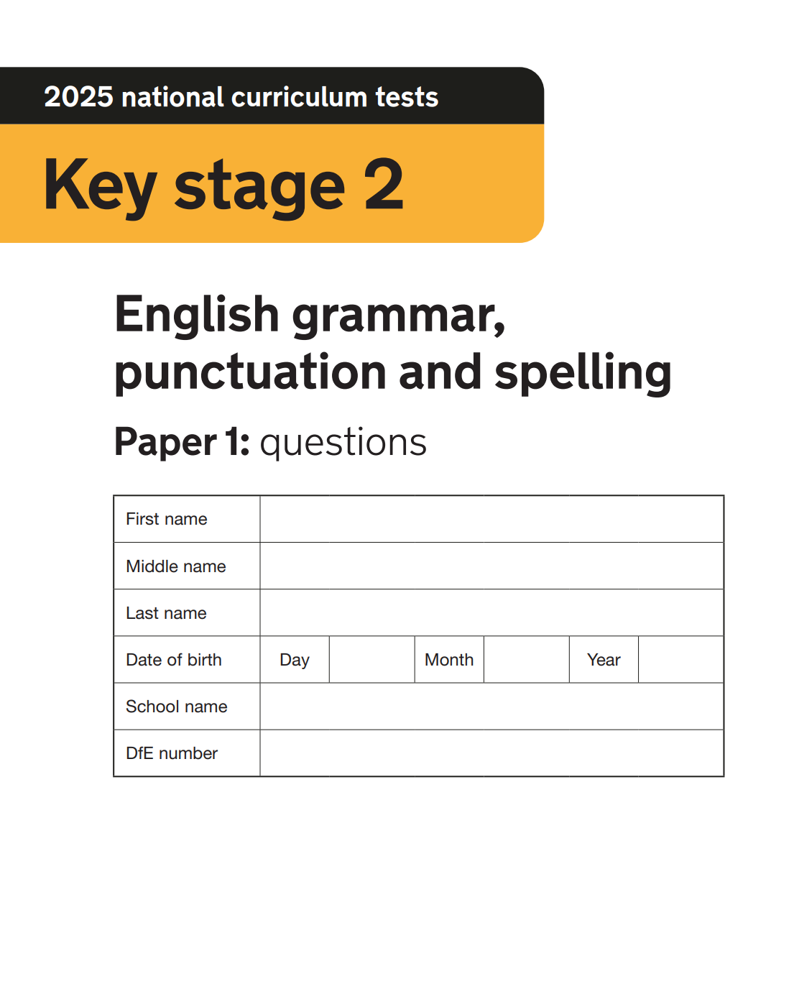
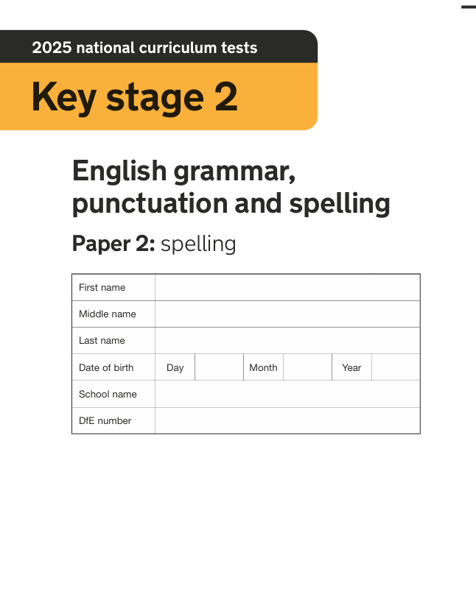
MIRJAM NILSSON​
FLORA BERGGREN​

Slide 32
English Grammar, Punctuation and Spelling (SPAG)
SPAG Paper 1:
Paper 1 – A detailed test of 45 minutes, requiring short answer questions, including some multiple choice
50 marks

Slide 33
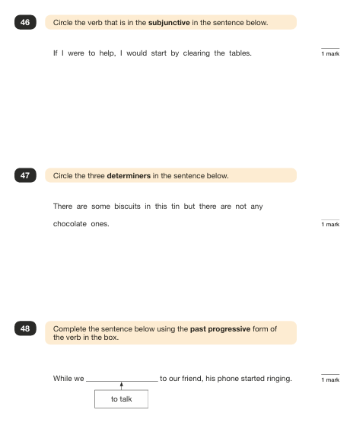
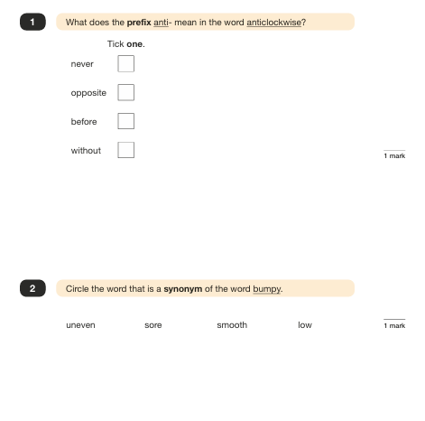

Slide 34
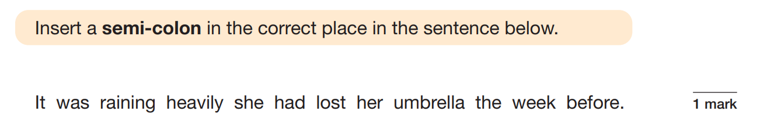

Slide 35
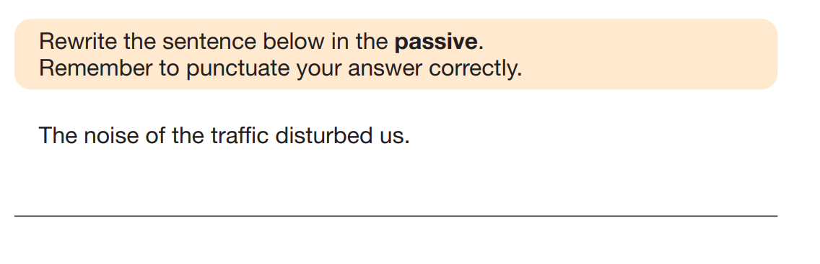
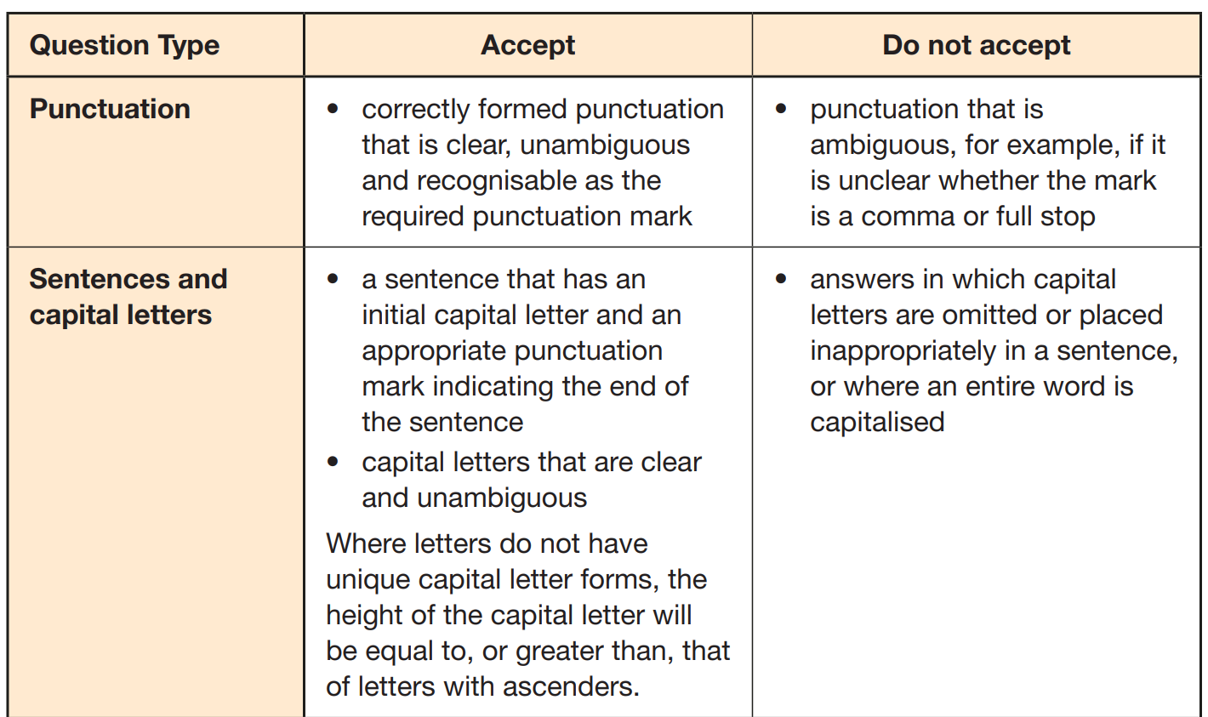
We were disturbed by the noise of the traffic

Slide 36
English Grammar, Punctuation and Spelling (SPAG)
SPAG Paper 2:
Paper 2 - 20 words given, lasting approximately 15 minutes – 20 marks
Marks for these two tests are added together to give a total for Spelling, Punctuation and Grammar - 70 marks combined

Slide 37
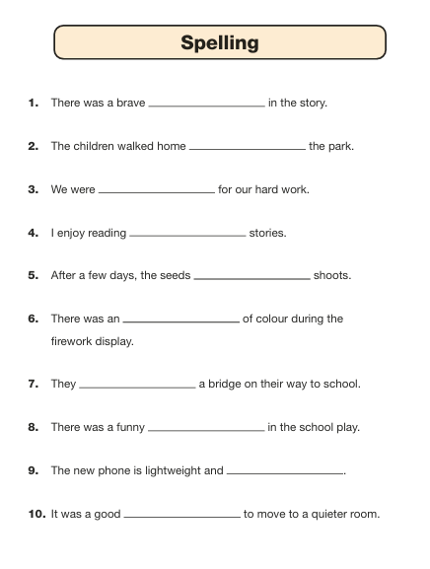
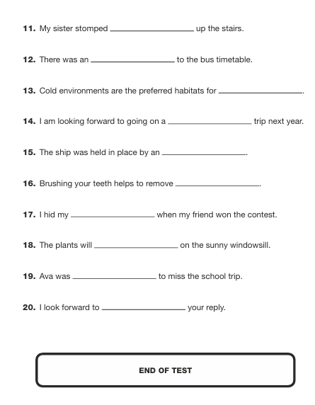

Slide 38
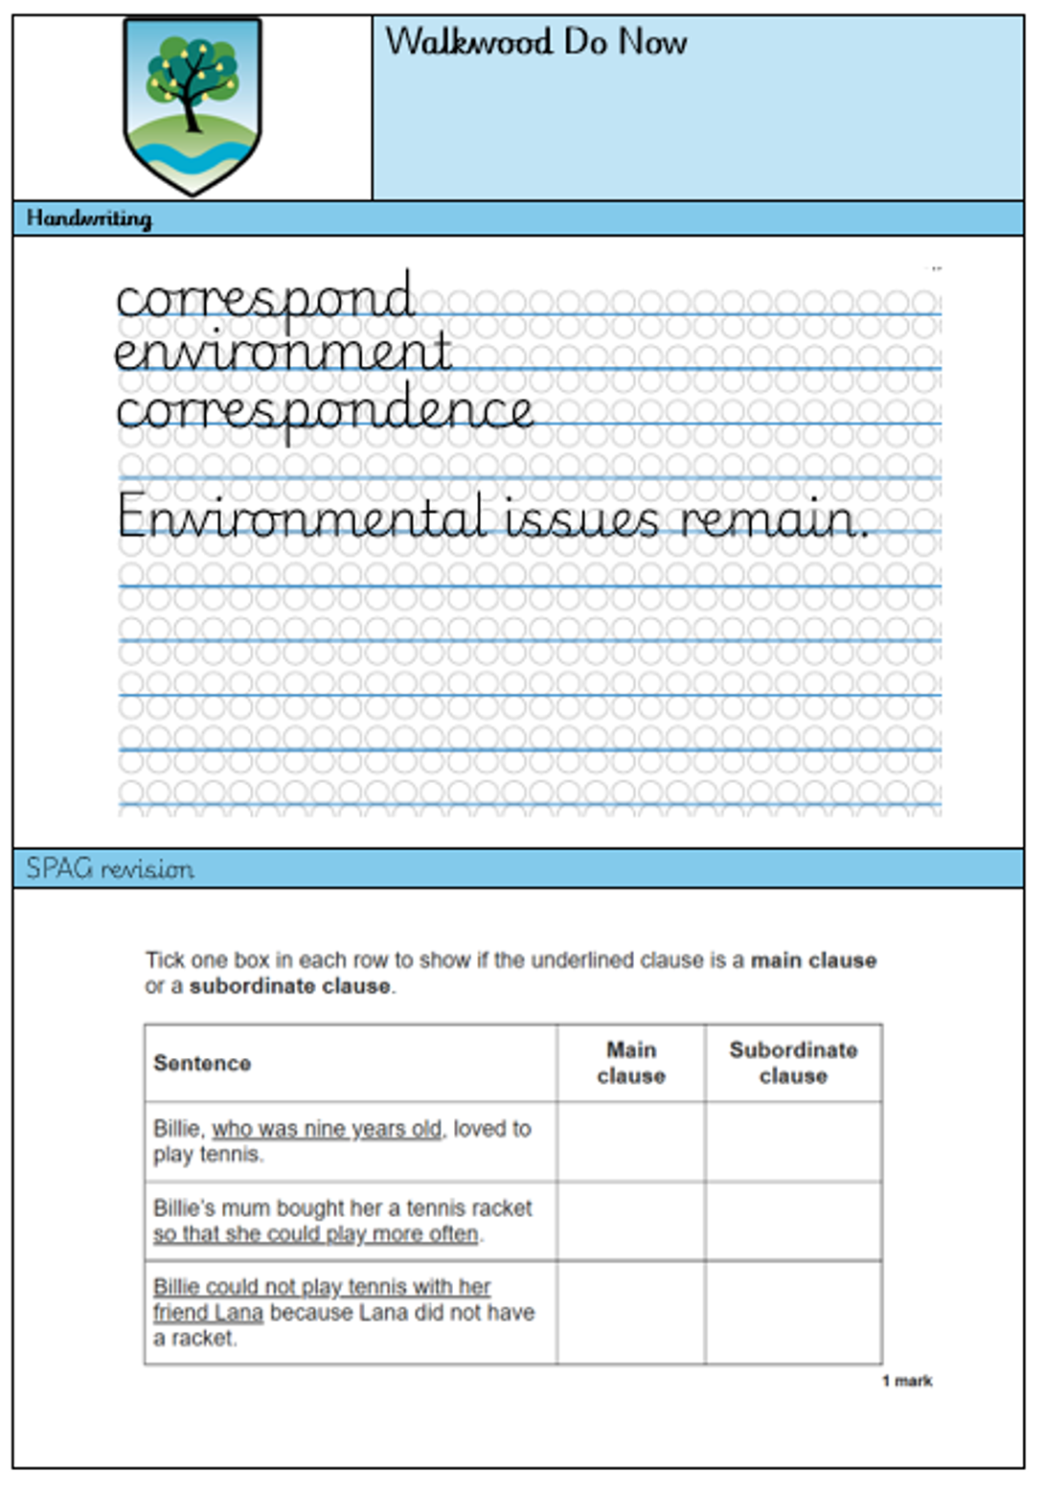
Do Nows
Do Nows have been introduced across year groups for over a year now. These are starters that are out on the tables as the pupils come into their lesson.
On these Do Nows, pupils can practise their spellings, handwriting joins and their SPAG revision.
These help with the retention of skills and habit of joins.

Slide 39

Ways to help at home with SPaG/writing:
Good readers become good writers. Identify writing features when reading (e.g. vocabulary, sentence structure, punctuation)
Practise and learn weekly spelling lists – make it as fun as possible
Encourage opportunities for writing such as letters to family or friends, shopping lists, notes or reminders, stories or poems
Write together – be a good role model for writing
Encourage use of a dictionary to check spelling and a thesaurus to find synonyms to expand vocabulary
Allow your child to use a computer for word processing, which will allow for editing and correcting of errors without lots of crossing out

Slide 40
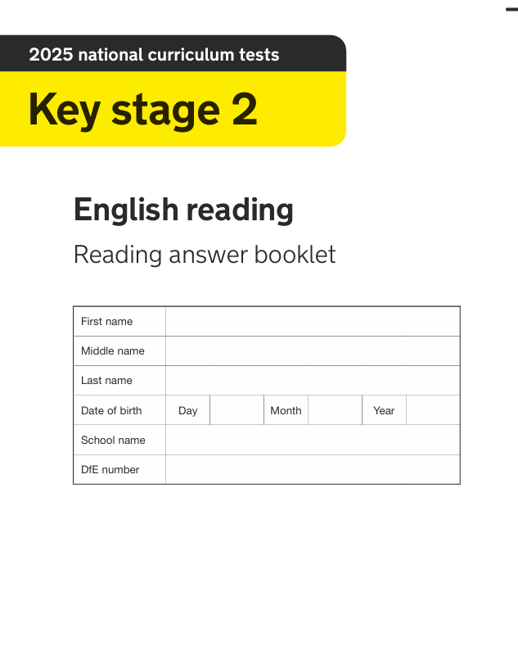

MIRJAM NILSSON​
FLORA BERGGREN​

Slide 41

The reading paper
A single test paper with three unrelated reading texts
60 minutes in total, including reading the texts and answering the questions
50 marks
Questions assess comprehension of reading
Some questions are multiple-choice or selected response, others require short answers and some require an extended response or explanation

Slide 42
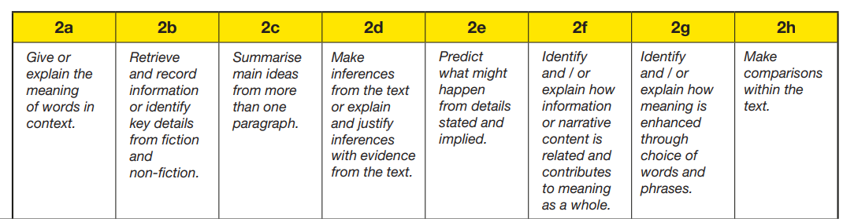
The reading paper

Slide 43
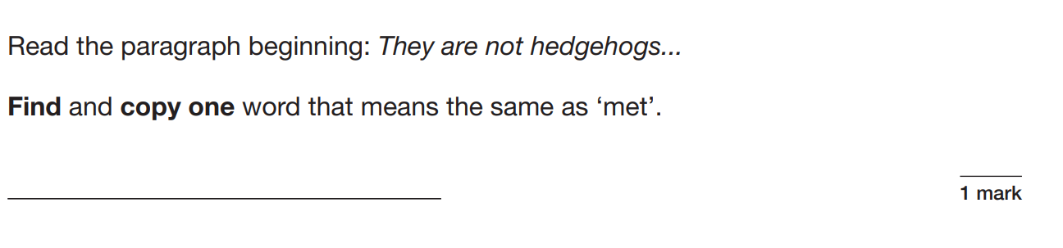
English Reading Paper – example questions:

Slide 44
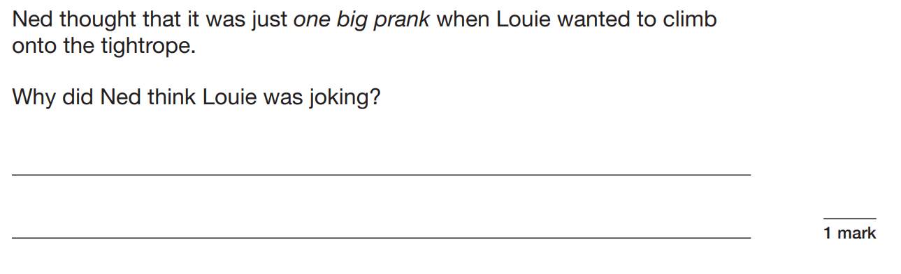


Slide 45
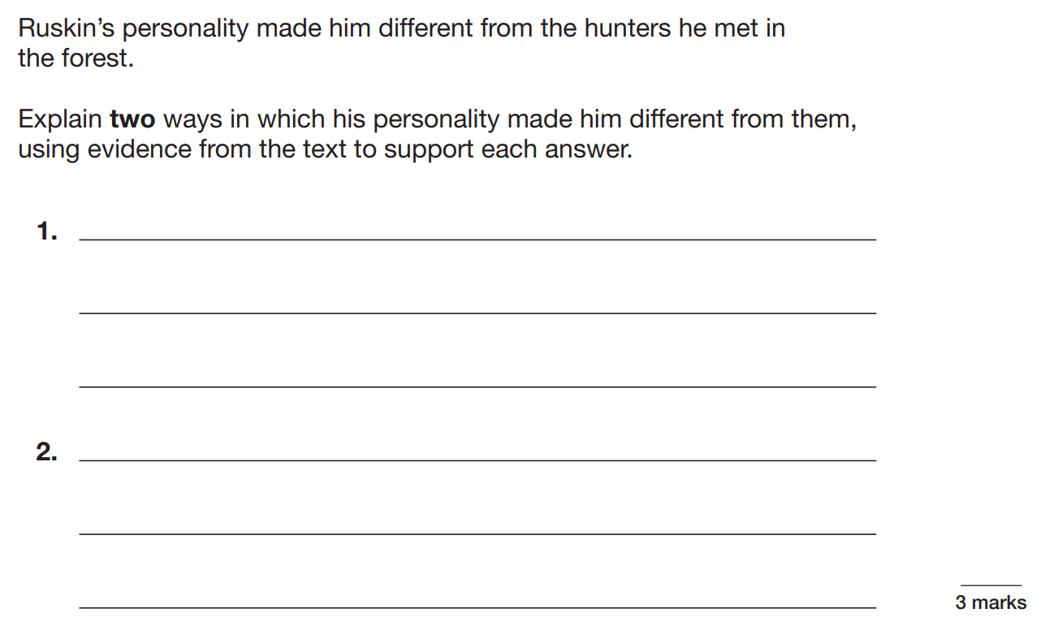


Slide 46
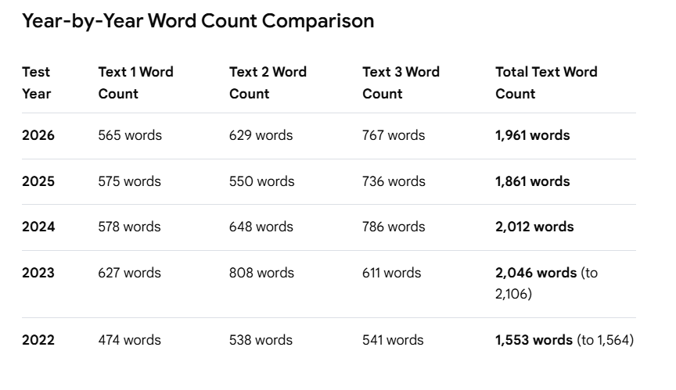
English Reading Paper – word count

Slide 47
KS2 – Comprehension
KS2 complete a reading comprehension weekly to expand their skills.
With this, they will be given set time in which to complete as they build their confidence.
On average for SATs, pupils have approximately 20 minutes per text (3 texts total).
To build their skills, we will all need to be applying highlighter skills into our comprehension teaching.
Can you apply your comprehension skills to the following? You have 7 minutes to complete this then move on to the extension.
Tantalising Treasure
I looked down at the remarkable nugget that was being held captive in my quivering hands. As would be expected from something being held against its will, it struggled. It made sudden bursts for freedom and bumped softly against my palms. Daring to sneak a peek at my mysterious discovery, I parted my fingers as slightly as I could. I watched as delicate wisps and sunbeams appeared to dance and play on its surface, creating a pearlescent aura around it that illuminated its fleshy cage. Having been found at the water’s edge, being lapped by frothy waves, the trinket was slick and almost impossible to grip. Yet, it was absolutely essential that I didn’t let it go… not after last time.
1. How did the narrator take a peek at the discovery?
________________________________________________________
2. What are two ways that the nugget shows that it does not enjoy being held?
____________________________________________________________________________________________________________________
3. What are the two things that danced on the objects surface?
_________________________________________________________________________________
4. What is the nugget being held in?
__________________________________________
5. Where was the trinket found? Use a quote to prove it.
_________________________________________________________________________________

Slide 48
Highlighters
Can you apply your comprehension skills to the following? You have 7 minutes to complete this then move on to the extension.
Tantalising Treasure
I looked down at the remarkable nugget that was being held captive in my quivering hands. As would be expected from something being held against its will, it struggled. It made sudden bursts for freedom and bumped softly against my palms. Daring to sneak a peek at my mysterious discovery, I parted my fingers as slightly as I could. I watched as delicate wisps and sunbeams appeared to dance and play on its surface, creating a pearlescent aura around it that illuminated its fleshy cage. Having been found at the water’s edge, being lapped by frothy waves, the trinket was slick and almost impossible to grip. Yet, it was absolutely essential that I didn’t let it go… not after last time.
1. How did the narrator take a peek at the discovery?
________________________________________________________
2. What are two ways that the nugget shows that it does not enjoy being held?
____________________________________________________________________________________________________________________
3. What are the two things that danced on the object’s surface?
_________________________________________________________________________________
4. What is the nugget being held in?
__________________________________________
5. Where was the trinket found? Use a quote to prove it.
_________________________________________________________________________________
By using a highlighter, pupils can identify key words in questions, then highlight the answers in the text.
This supports accuracy in transcription, so instead of the answer being in a sea of text, it is bold and clear to transfer.
When this is standard practise, it improves speed, accuracy and results. It can also be used in their SATs papers as it would be considered standard practise.

Slide 49
Ways to help at home with reading:
Focus on developing an enjoyment and love of reading
Enjoy stories together – reading stories to your child at KS1 and KS2 is equally as important as listening to your child read
1.Establish a Reading Routine
Set a Regular Reading Time: Create a dedicated time for reading each day, whether it’s before bed or after school, to build a consistent habit.
2. Encourage Choice in Reading Material
Involve Them in Book Selection: Take your child to the library or bookstore and let them choose books that interest them. This promotes ownership and excitement about reading.
Diverse Genres: Encourage your child to explore various genres (mystery, fantasy, non-fiction, etc.) to broaden their reading experience.
3. Discuss What They Read
Ask Questions: Engage your child in discussions about the books they are reading. Ask questions that focus on retrieval ‘Who…, where…, when…, why…?’, understanding vocabulary ‘Can you find an example of a word that means…?’ and inference ‘How do you know…? How can you tell that…? Explain why…’
This relates to all types of reading at home.

Slide 50
Our lessons
Over recent years, year 6 and the wider English curriculum had complete overhaul. We have introduced Whole Class Reading every week, text retrieval, ‘Do Nows’ and a more rigorous recall system for comprehension and spag skills.
For every comprehension, pupils are asked to highlight the answer in the text before writing it down.
This has already started to make a difference.

Slide 51
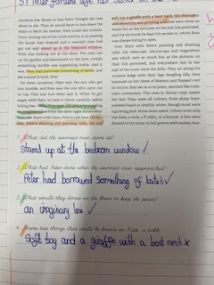

Slide 52
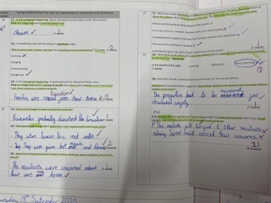

Slide 53
How do we prepare the pupils?
Three formal practice papers (September/January/March)
PIXL data provides us with individual weaknesses for each pupil and gaps in class to address
Renaissance reading program to track reading levels and comprehension
Spelling Shed
Weekly homework tasks linked to reading and spelling/SPaG

Slide 54


Useful books and websites....
CGP, Letts, Collins, Rising Stars – all do study guides
BBC Education have produced a whole host of materials for KS2. Follow the KS2 link and then select either Maths or English. Each area usually has an information section for reading, plus an activity and then quiz which is marked online. Some aspects require a subscription - http://www.bbc.co.uk/education
A site with both Maths and English based quizzes which are marked as you go along - http://www.educationquizzes.com/ks2/maths/
A site with a range of information and questions – great for revision purposes! http://www.icteachers.co.uk/children/children_sats.htm

